Slide 1

CMPT 276 team 3 release 0 presentation
Members: Nichol yip, mac Liu, Eric Wong, Jeremy lee, Tanvir khan

Slide 2

Meeting schedule
Mandatory meetings before class on Mondays from 10:30am – 11:20am
Optional meeting after class M W F after class from 12:30pm – 1:30pm
Online discussion is encouraged on Saturday nights at 8:30pm – 9:30pm using either Skype/Facebook Messenger/Discord

Slide 3



Communication tools/techniques
Communication tools we will use outside of school would consist of either Skype, Facebook Messenger or Discord.
Members of the group are encouraged to ask questions in the group chat if they need help on anything.

Slide 4
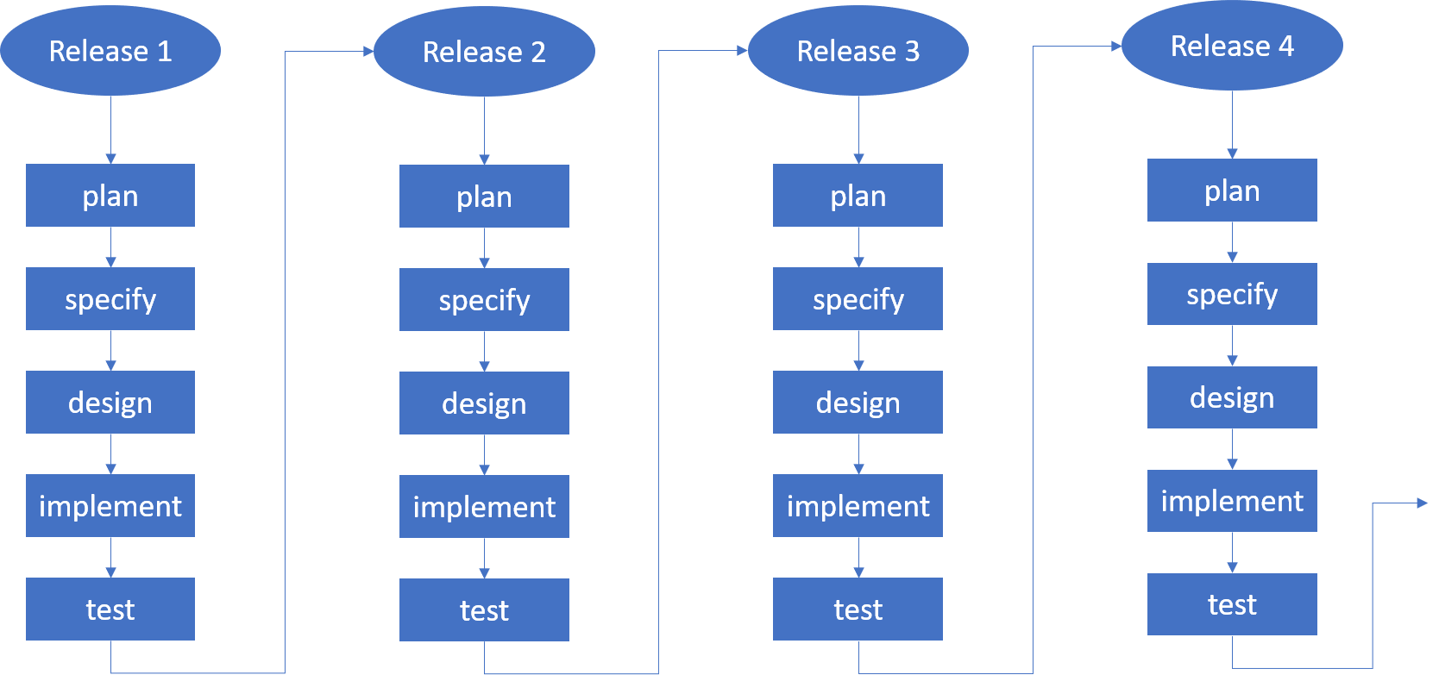
Software methodology
Members are expected to follow an incremental development model while working on the project, where the project will be divided into smaller releases.

Slide 5

Testing and Quality Assurance tools
To ensure the quality of our code, tools we will use for testing and quality assurance would consist of JavaScript Sandbox and a manual code in a separate JavaScript file. (which we will build up with each release)

Slide 6


Main Implementation Language / Software Repository
Main implementation language would be JavaScript and all code would be stored using GitHub.

Slide 7
Detailed Use Cases For Next Release
Chip 8 Core
Memory, register, stack, opcode
Chip 8 Functions
Load program, reset, start, stop
Display
Chip 8 display, html canvas
Visualizer
Testing for display
Testing for each opcode
Testing the core function for chip 8
Performance testing
Output error log for each error

Slide 8
Work Breakdown
Name | Release 1 Tasks
Nichol | Display/Updates to Product Document
Jeremy | Automated Testing
Mac | Display
Eric | Visualizer
Tanvir | Visualizer
ALL GROUP MEMBERS ARE EXPECTED TO WORK ON THE DEBUGGIN PROCESS AND THE CHIP 8 CORE
Name | Release 2 tasks
Nichol | Sound/Start Game 1/ Updates to Product Document
Jeremy | Timers/Start Game 1
Mac | Hex Keyboard/Start Game 1
Eric | Chip 8 Tool
Tanvir | Chip 8 Tool
NOTE: THIS IS THE WORK BREAKDOWN ONLY FOR RELEASE 1 AND 2.

Slide 9
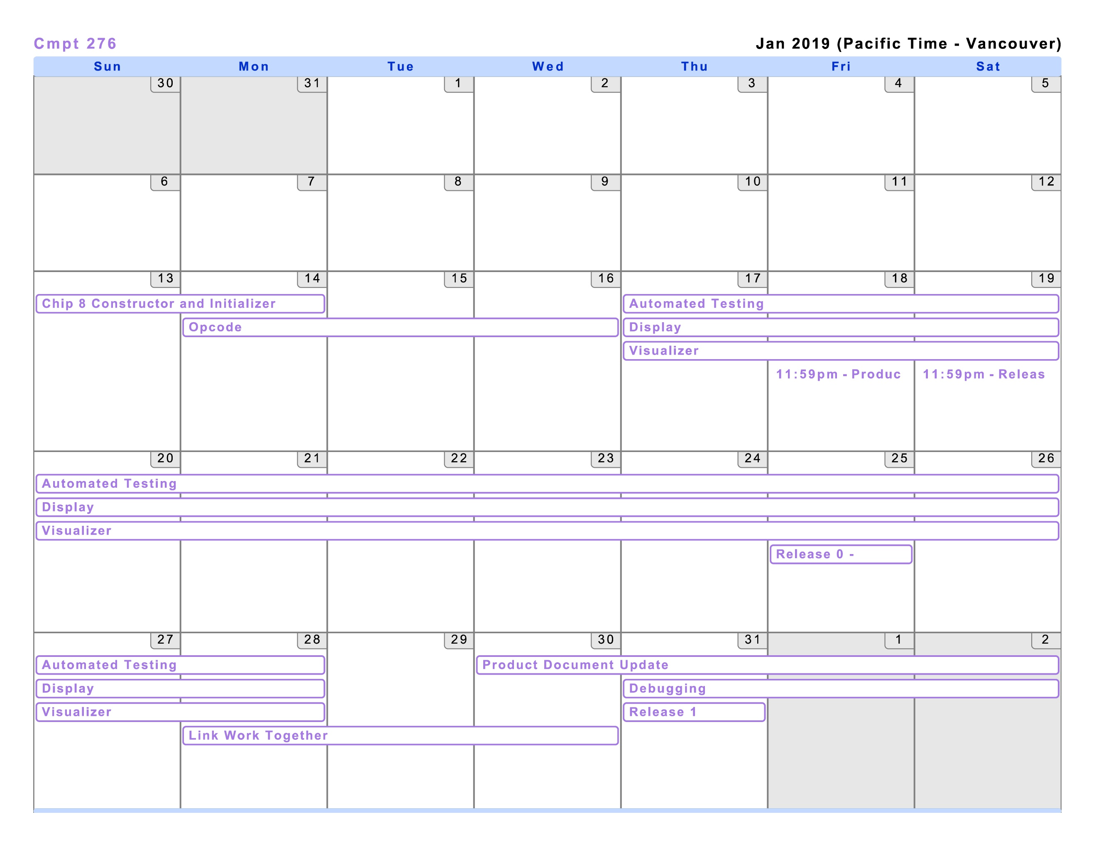
Future Schedules (January)

Slide 10
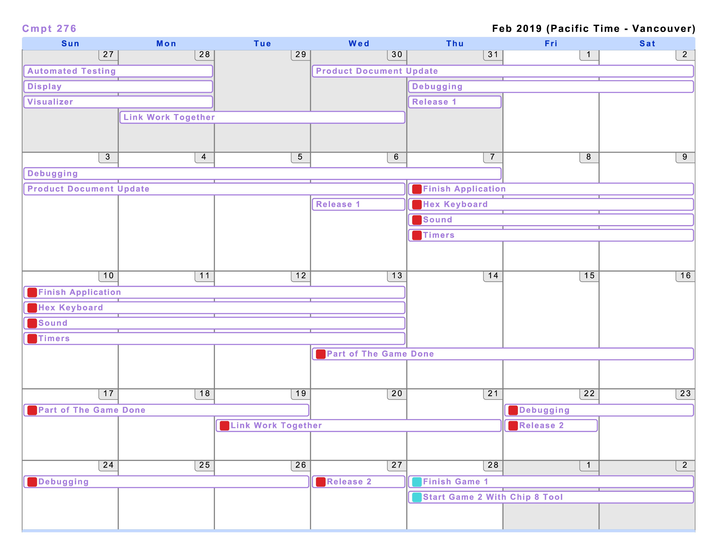
Future Schedules (February)

Slide 11
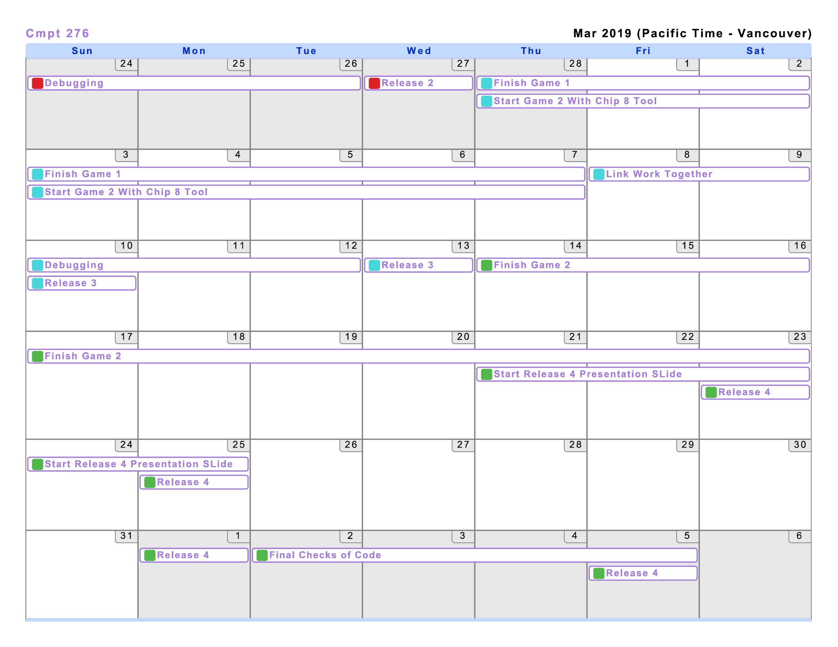
FUTURE SCHEDULES (March)

Slide 12
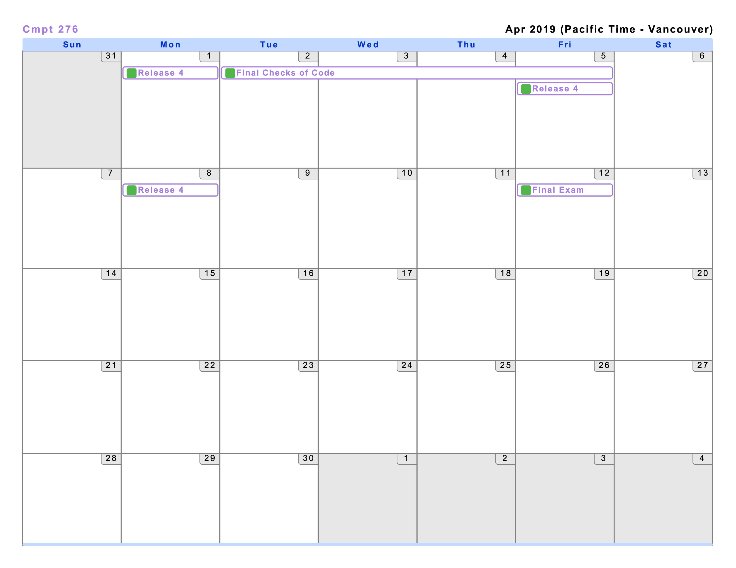
Future Schedules (APRIL)

